Slide 1
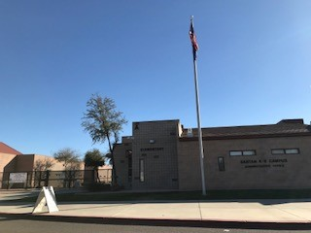
Santan Elementary
CHANDLER UNIFIED SCHOOL DISTRICT NO. 80 A Grade “A” District By the Arizona Department of Education
Welcome to Kindergarten Open House
at Santan Elementary,
an A+ School of Excellence™!
(

Slide 2
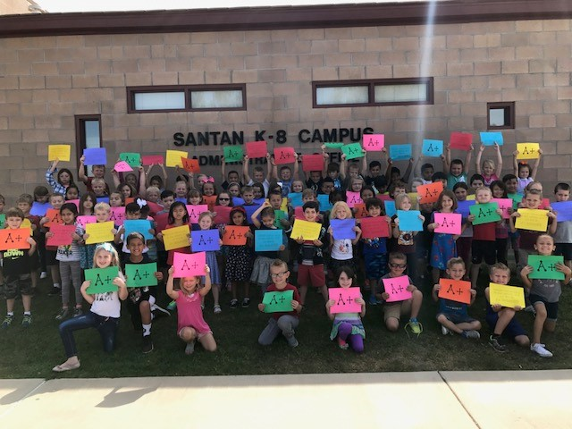
Santan Elementary
ABOUT OUR SCHOOL

Slide 3
Santan Elementary
Our Santan Vision Statement
Santan Elementary, an enthusiastic community,
rising up to the ongoing challenges of
meeting the educational
and social needs of all students
while building positive character,
instilling a love of learning,
and nurturing strong partnerships with families.

Slide 4
Santan Elementary
INTRODUCTIONS
Mrs. Amy O’Neal , Principal
Miss Jillian Curland, Kindergarten Teacher
Mrs. Michelle Dalby, Kindergarten Teacher
Mrs. Kally Deymonaz, Kindergarten Teacher
Mrs. Jacqui Hughes, Kindergarten Teacher
Mr. Justin Durham, Dean of Students
Mrs. Melissa Edwards, Counselor
Ms. Dominica Peterson, Administrative Assistant
Mrs. Elaine Kristal, Attendance Registrar
Mrs. Ivette Santos, Health Assistant

Slide 5
Santan Elementary
ADMISSION
Your child must be 5 years of age by August 31st
to register for the 2018-2019 school year.
If your child turns 5 years of age between
September 1st – December 31st, she/he may be tested
for Early Kindergarten Entrance.
If you feel that your child displays kindergarten readiness skills, please contact the Assessment Office at 480-812-7674 to inquire about testing.

Slide 6
Santan Elementary
KINDERGARTEN READINESS INDICATORS
Social & Emotional
Sits quietly for 10-15 min.
Clear understanding of the concept of cause & effect.
Shares with others (teamwork).
Will follow simple directions
(2-3 steps).
Able to recognize and follow authority.
Exhibits self-control and respect for others.
Understands and reacts appropriately to consequences or redirection.
Separates from parents.
Language, Listening & Speaking
Recognizes and identifies colors.
Pays attention to adult-directed tasks and direction.
Speaks clearly using complete simple sentences using 5-6 words.
Listens to stories without interruption.
Can use their imagination to tell or retell a story by looking at pictures.
Recognizes rhyming sounds.

Slide 7
Santan Elementary
KINDERGARTEN READINESS INDICATORS
Large & Fine Motor Skills
Prints his/her name.
Holds a pencil correctly.
Uses and handles scissors correctly.
Draws basic shapes.
Bounces a ball.
Walks and runs without falling.
Turns pages in a book easily.
Self-Management
Can say his/her first and last name clearly.
Manages bathroom needs independently.
Is able to feed themself.
Can button and use zippers.
Ties shoes independently or with very little help.

Slide 8
Santan Elementary
KINDERGARTEN READINESS INDICATORS
Pre-Reading Skills
Traces and/or writes letters and numbers.
Recognizes letters of the alphabet.
Recognizes sight words and environmental print (i.e. stop).
Identify letters in his/her first and last name easily.
Verbally recites the alphabet in order.
Identifies rhyming words.
Currently or is starting to identify the beginning letter sound of words.
Identifies some alphabet letters.
Pre-Math Skills
Names basic shapes.
Begins to recognize numbers 1-20.
Understanding of times of day (morning, afternoon, evening).
Sorts similar objects by color, size, and shape.
Counts from 1-20+.
One-to-one correspondence while counting (is able to touch an object and count without skipping).

Slide 9
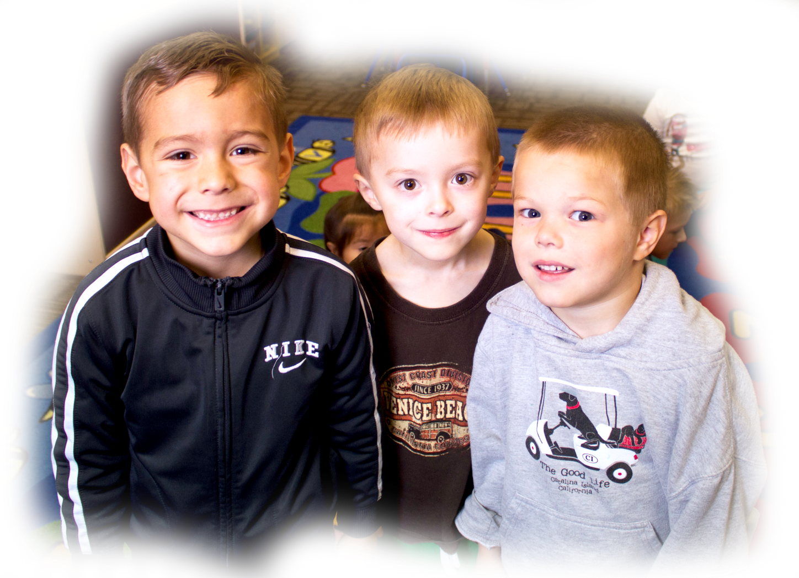
Santan Elementary
SPECIAL AREA CLASSES
Kindergarten students also have the opportunity to learn special subjects! Students receive (2) 30-minute sessions with our special areas teachers of the following classes during a 6-day rotation:
Physical Education
Music Education
Library and Technology Class

Slide 10
Santan Elementary
LUNCH TIME
Kindergartners eat in the lunchroom every day before recess. They spend 20 minutes on the playground + 20 minutes in the cafeteria.
Students may purchase school lunch or bring a sack lunch from home.
There are four ways parents can put money in their child’s lunch account:
Log onto: www.MyschoolBucks.com to load money into the account.
Download the app in iTunes or the Play Store on your smartphone.
Prearrange payment through the school cafeteria.
Send your money in an envelope labeled with your child’s name, teacher’s name and room number.

Slide 11
Santan Elementary
SAMPLE DAILY SCHEDULE
Bellwork/Fundations (handwriting & phonics)
Morning Meeting
Calendar Activities & Learning Goals
Guided Reading/Daily Five
Instruction tailored to each student's level & Independent Reading, Writing,
Phonemic Awareness and Phonics Activities
Recess/Lunch
20 minutes to play & 20 minutes to eat
Shared Reading
Big books, poems, & songs
Writing
Handwriting & journals
Special Classes
Library, Music, P.E., Technology
Snack
Social Studies
Science/STEM activities
Math - Challenge Period
Read Aloud
Teacher models fluency & vocabulary development

Slide 12
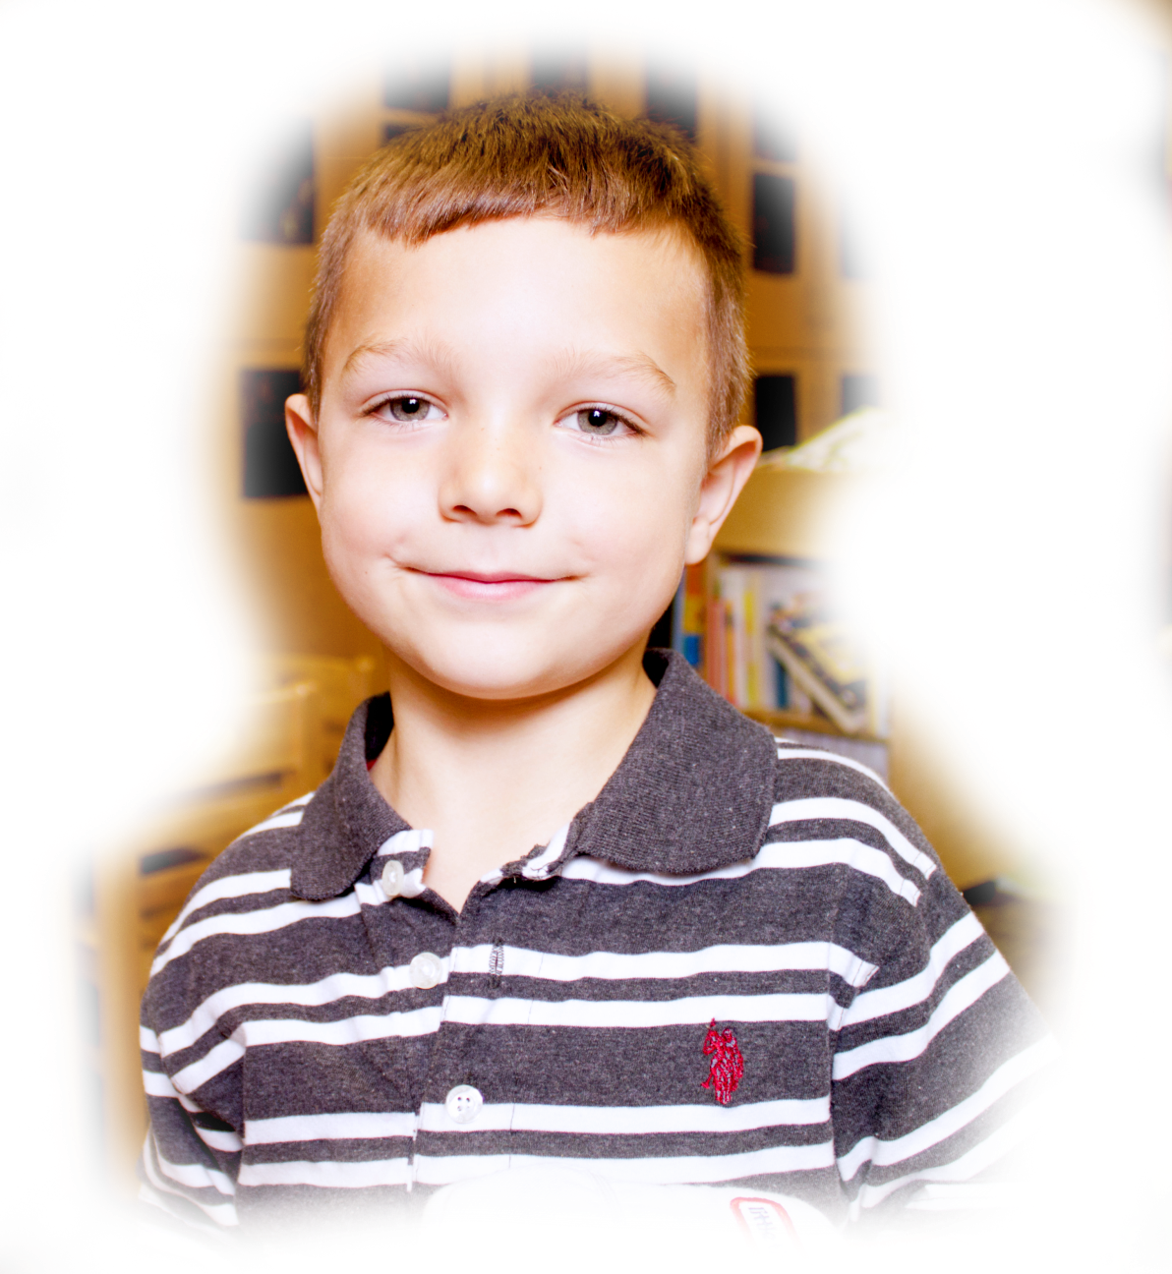
Santan Elementary
KINDERGARTEN CURRICULUM
Arizona’s College & Career Ready Standards
Language Arts (Reading, Writing, Presenting, Listening & Speaking)
Mathematics
Science
Social Studies
Technology/Library
Health
Physical Education
Art – Art Masterpiece
Music

Slide 13
Santan Elementary
READING
D.I.B.E.L.S. Universal Reading Screening Tool & Benchmark Assessment: Beginning of Year (July), Middle of Year (December), and End of Year (May).
Fundations (phonics-based reading program)
H.M.H. Journeys textbook series
Read Alouds
Shared Reading
Guided Reading
Literacy Centers/Stations/The Daily Five

Slide 14
Santan Elementary
WRITING
Writer’s Workshop
Thinking Maps
Write from the Beginning
Spelling
H.M.H. Journeys encompasses Reading, Writing and Spelling

Slide 15
Santan Elementary
MATH
McGraw Hill GoMath textbook series in K-5th grade
Read, write & build numbers 0-20
Recognize ordinal numbers 1st-5th
Interpret & solve simple graphs
Add & subtract facts to 10
Create, solve and act out word problems to 10
Classify & sort objects
Identify basic 2-D & 3-D shapes in the real world
Measure objects using non-standard measurement
Identify numbers before, after & in between 0-20
Estimate quantities 1-20 as more/less than 5 or 10

Slide 16
Santan Elementary
SCIENCE & SOCIAL STUDIES
We integrate our Science and Social Studies units into our reading and writing curriculum strands.

Slide 17
Santan Elementary
CURRICULUM INFO.
Visit our Instructional Resource Center (IRC) webpage to obtain more information about the curriculum and standards at: http://cusd80.com/Page/31389
Download the free
“Kindergarten Under Construction Student
Workbook: A guide created to help families
prepare their children for kindergarten” at:
http://www.cusd80.com/Page/92334

Slide 18
Santan Elementary
PARENTAL INVOLVEMENT
Classroom Support
Sign-up with teacher to work with small groups
Supervision and support Center, Reading, and Writing Workshops or Centers/Stations
Preparing materials (at home or at school)
Art Masterpiece
Class Celebrations
Field Trips
School Support
PTO
Art Masterpiece
Workroom Volunteer
School Events & Functions
Site Council
Running Club/Meets
Book Fairs

Slide 19
Santan Elementary
BEFORE & AFTER SCHOOL CARE
Kids Express
You can now register for the Kids Express program online. For more information, call (480) 224-3900 or email: Kids-Express@cusd80.com. You can also register in person at the Community Education Department at the CUSD District Office.
6:30 AM – 6:30 PM
ADHS licensed
Quality staffing
Structured environment
On-site childcare

Slide 20
Santan Elementary
CLUB C.U.S.D. ENRICHMENT PROGRAMS

Slide 21
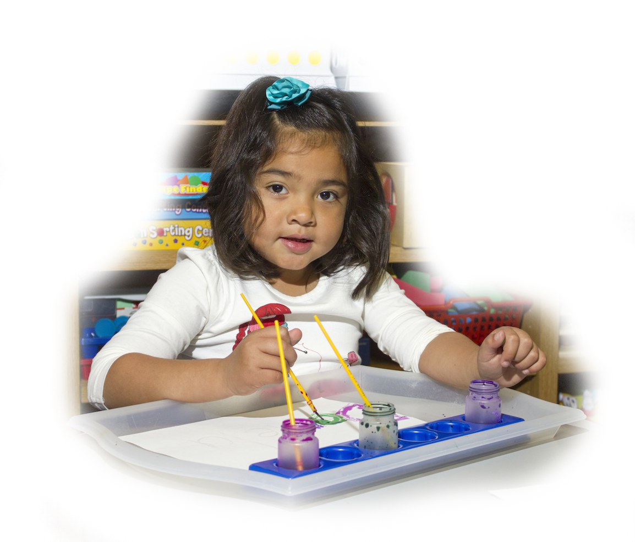
Santan Elementary
CLUB C.U.S.D. ENRICHMENT PROGRAMS
CLUB C.U.S.D. is filled with Athletes in Training and Kre8tive Kids Discovering their Dreams on every campus!
Now is the Prime Time (Athletics) to focus on Science, Technology, Engineering, and Math!
Imagine what Tomorrow will be for your child as he/she explores the Elements (Music) of aviation, claymation, and robotics! Spice Up (Arts & Design) and Tumble (Town) into something new! Uno, Dos, Tres! (Spanish)

Slide 22
Santan Elementary
THANK YOU FOR COMING!
At this time, we invite families to visit each of our Kindergarten classrooms for an opportunity to work with the children on an activity. All of our Kindergarten classrooms are located in
Building E, and the classroom numbers are below:
Miss Curland – room 1
Mrs. Dalby – room 2
Mrs. Deymonaz – room 11
Mrs. Hughes – room 10

